Slide 1

Colonial Cribs
MTV Cribs’ Craig Kielburger Episode: An Example of Colonial Discourse
Notes:
In this presentation I will discuss how the MTV Cribs Craig Kielburger episode is an example of colonial discourse. As I will disclose, this is largely because it depicts voluntourism and it compares Western culture and Westernisms to their Maasai counterparts. Further, the heart of the video’s colonial discourse lies within the language employed by Kielburger and his perspective as a western charity spokesperson.

Slide 2
Craig Kielburger
Canadian Human Rights Activist (1)
Started We Charity (Free the Children) in 1995 when he was 12 (1)
Started Me to We social enterprise in 2008 which specializes in “socially conscious products”, leadership training and travel experiences (1)
Half of the profits from Me to We go to We Charity (1)
WE Charity scandal (1)
WE’s work atmosphere as “cultish” (2,3)
Notes:
Before I begin with my analysis, it is important to first provide some background on the host of this MTV Cribs UK episode. Mr. Kielburger is a Canadian human rights activist who started the We Charity, formerly known as Free the Children, in 1995 when he was 12. In 2008, Kielburger began a social enterprise called Me to We which specializes in socially conscious products, leadership training, and travel experiences or voluntourism. The charity has been the center of two scandals. The most well known of these is how the Trudeau administration is said to have unethically awarded the organization a government contract for teaching aide due to Trudeau family donations to the charity. Another scandal that is more recent is the possibility that the organization exhibits a cult-like work environment.

Slide 3
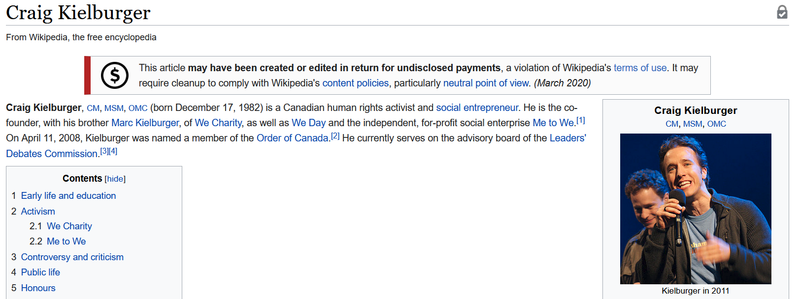
Notes:
An interesting note is this blurb on the Wikipedia page for Craig Kielburger that denotes “this article may have been created or edited in return for undisclosed payments”. The point being that though the We organization and its subordinates are for charity, there is a business enterprise side of the charity and it is said to have been involved in some problematic pursuits.

Slide 4
MTV Cribs
“Takes you on exclusive tours through the domestic sanctuaries that some of today's most favorite stars call home” (4)
Cribs UK episode
Notes:
MTV Cribs, specifically the UK version of the show is aimed at a younger western audience. It is not where you would expect to find colonial discourse. With this viewership in mind and the focus on Kielburger and the Me to We enterprise, a colonial discourse certainly begins to take shape.

Slide 5

Video Summary
Notes:
This particular episode goes against the grain of the typical Cribs presentation and Kielburger self-consciously acknowledges this (0:20). This is further emphasized in the video description, “A spoof on fancy cars and gold leafed bathrooms, this episode takes you on a tour of the Free the Children compound where people come to volunteer and help build schools in the Mara”. The episode is designed to contrast Hollywood mansions with the Free the Children compound in Kenya. Instead of high end ‘specs’ that are typical in the show, this episode highlights a twig tooth brush, a green machine, and Maasai “5.1 Surround Sound” (0:07). Kielburger proceeds to exoticize Maasai culture as he uses western food labels to describe Maasai dishes, stating that the time frame for ordering pizza is seven hours as opposed thirty minutes. Later he highlights the Maasai’s reverence for beef and how it is typical to drink the fresh milk and blood of the animal. The video then digresses into a sort of advertisement for the Me to We volunteer program. It ends abruptly with Kielburger stating that he needs to get back to work and that “Unless you’re here to build a school, get out”.

Slide 6
Voluntourism
“The merging of volunteering and tourism - the growing trend of people travelling to do some good in other communities” (5)
Training of local communities
Free workforce
Help needed on a variety of projects
Cultural exchange
Notes:
Clearly, the video represents the act of voluntourism. But what is that and why is it indicative of colonial discourse? It is defined as ____________ it seeks to train local communities, provide a free workforce, provide aide on a variety of projects, and promote cultural exchange. Naturally, this language is coming from a western perspective and herein lies the video’s colonial discourse.

Slide 7
White Savior Colonizer Language
“It’s amazing what they managed to build in the absolute middle of nowhere in Africa” (3:25)
“mosquito nets are more for decoration than function” (4:57)
“So immersed are they in prejudice that they do not believe that blacks can formulate their thoughts without white guidance and trusteeship” (Biko 89).
“We have to rewrite our history and produce in it the heroes that formed the core of our resistance to the white invaders” (Biko 95)
Notes:
Kielburger’s perspective and presence in the video lead to his language aligning with that of a colonizer thus furthering the colonial discourse present in this episode. For example, he states__________ and _________. I have included some of Steve Biko’s words on the ongoing event of colonialism to illustrate the tension between Kielburger’s voluntourism and his ideas on Black consciousness. The tension manifested by this juxtaposition is yet another indicator that there is a colonial discourse at hand.

Slide 8
Depicts and Praises Colonial Education
“Unless you’re here to build a school, get out” (6:10)
Lee Maracle, “Heartless Teachers”
Notes:
Finally, because of Kielburger’s final remarks in the episode, the video cements itself as an example of colonial discourse. Kielburger’s last words to stay out unless you want to build a school carry with them very heavy colonial undertones. Anytime that education is taking place, it is important to investigate the pretenses for education. In the video, Craig’s crib is in Kenya and is a product of harnessing volunteers to build the compound. Throughout the video he suggests that he is there for philanthropic pursuits. But what kind of education will be taking place once a school is built? Are the Maasai people learning about themselves or are they expected to engage with a western curriculum? These are important questions to ask in response to the video. The depiction of education here elicits colonial discourse for it discusses education by a predominantly western organization in Kenya. The colonial undertones of this are brought to light especially when we look at Lee Maracle’s words from “Heartless Teachers”.

Slide 9
I realize you hold no gun to my head, dear teacher, but it was your culture that spawned physical genocide and now you ask me to erase the shadow of my grandmother. Before you ask me to erase her, please reduce yourself to a shadow. Then, we will at least be equal. At base zero. I am willing to negotiate a whole new culture, if you like. Otherwise, keep your offensive words locked in your narrow mind.
Notes:
The borderline advertisement that this episode is presents an example of colonial discourse because of its depictions of voluntourism, white savior colonizer language, and references to the necessity of western education . This primarily stems from the exploits of Kielburger’s WE Charity and Me to We brand. The contrast of western and Kenyan Maasai cultures serves to paint the Maasai way of life as different from the western way, and Kielburger’s remarks on these differences are certainly forms of colonial discourse for he is representing a culture that is not his own. His voice is the only voice in the video, though this is traditional of MTV Cribs to have the proprietor of the “crib” to narrate the entire episode. When we look at the words of Biko and Maracle, the colonial discourse of the video becomes less opaque as there is friction between Biko and Maracle’s remarks on colonialism and Kielburger’s praise for his voluntourism endeavor. Further, when we account for the We Charity’s involvement in multiple scandals, this goes to show that Kielburger’s organization is not a moral authority and is realistically just like any other cooperation or large organization. Its existence as a western organization that seeks to better other societies carries with it colonial implications as it seeks to educate them. As previously mentioned, the colonial discourse present in the video is cemented with this call to educate the Maasai, there is no purpose in going there unless you want to build a school. What kind of school however, we do not know.

Slide 10
Sources
https://en.wikipedia.org/wiki/Craig_Kielburger
https://www.canadaland.com/inside-the-cult-of-kielburger/
https://nationalpost.com/news/caring-is-cool-craig-and-marc-kielburger-have-always-had-a-knack-for-saying-the-nicest-things
https://www.imdb.com/title/tt0276656/
https://www.globalteer.org/voluntourism/
Biko, Steve, “Chapter 14: Black Consciousness and the Quest for a True Humanity”. In I write What I Like: A Selection of His Writings. Ravan Press, 1996, pp. 87-98.
Maracle, Lee, “Chapter 9: Heartless Teachers”. In I am woman: a native perspective on sociology and feminism. Press Gang Publishers 1996. pp. 79-82.

